Slide 1
Object-oriented programming
Daman Virdi

Slide 2
Object-oriented programming
Object-oriented programming is a programming paradigm based on the concept of "objects", which can contain data and code: data in the form of fields, and code, in the form of procedures.
A feature of objects is that an object's own procedures can access and often modify the data fields of itself.

Slide 3
In object-oriented programming you write classes that represent real-world things and situations, and you create objects based on these classes.
When you write a class, you define the general behavior that a whole category of objects can have.

Slide 4
Instances of Class
Making an object from a class is called instantiation,
And you work with instances of a class.

Slide 5
Attributes
Variables that are accessible through instances like this are called attributes.

Slide 6
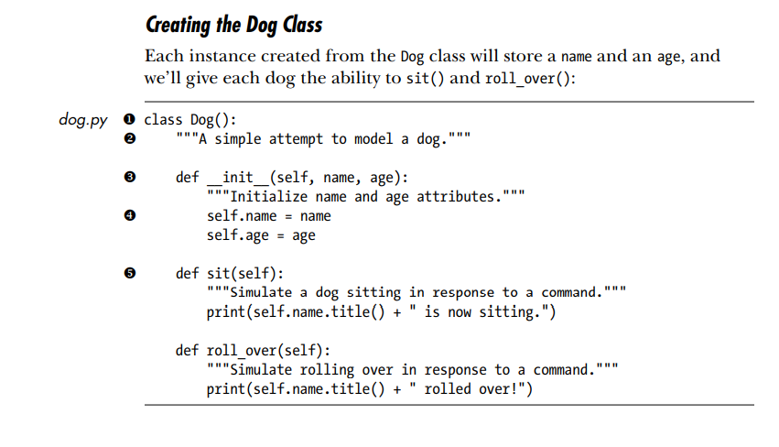
Creating and Using a Class

